Slide 1
Basic Forensics Methodology
Without altering or damaging original source, acquire and isolate evidence
Authenticate that recovered evidence is the same as the original.
Document the crime scene
Verify document integrity
Maintain chain of custody
Establish audit trail of all processes applied to computer based evidence.
Must be third party repeatable
Analyze data without modifying it.

Slide 2

Methodology
ACPO Guidelines
Principle 1
No action taken by officers or their agents should change data held on a computer or other media which may subsequently be relied upon in court.
Principle 2
In exceptional circumstances where a person finds it necessary to access original data held on a target computer that person must be competent to do so and to give evidence explaining the relevance and implications of their actions.
For further information, consult the ACPO Good Practices Guide.

Slide 3
Computer Forensics Development
Disk Forensics
Relatively well developed
System Forensics
O/S Dependent
Network Forensics
Includes ID systems
Internet Forensics
Includes ISP logs etc.

Slide 4
Disk Forensics Functions?
Recover:
Deleted files
Passwords
Cryptographic keys
Analyze file access, modification and creation times.
View/analyze:
Logs, system, application, other …
Identify a user or program’s system activity.
Analyze e-mail
Source
Content.

Slide 5
Disk Forensics
Requires (bit-stream) image copies
Include slack space, unallocated space, paging (swap) files, and deleted file fragments.
Investigators must be able to demonstrate compliance with evidence rules
Integrity can be demonstrated with a message digest.

Slide 6
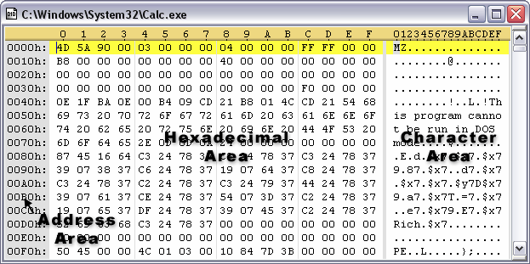
Disk Forensics
Well established methodology for court preservation and presentation.
Readily available commercial tools
Love Bug Case Study
Hex Editors and Microsoft Office Documents
Michael Buen & Onel de Guzman
Jurisdiction Issues

Slide 7
Commercial Forensics Tools
Tools and Vendors include:
EnCase
Guidance Software Pasadena, CA
Forensic Tool Kit (FTK)
AccessData
SafeBack
New Technologies, Inc. (NTI), Gresham, Oregon

Slide 8
EnCase
Considered a L.E. leader in stand-alone forensics analysis.
Widely accepted in court.
Facilitates examination of files, including deleted files and unallocated data.
Produces reports and extracts without altering original data.

Slide 9

FTK
AccessData’s Forensic Toolkit® (FTK) can perform complete and thorough computer forensic examinations.
Features powerful file filtering and search functionality.
Customizable filters allow sorting through thousands of files to quickly find evidence.
Recognized as a leading forensic e-mail analysis tools.

Slide 10
Other Forensic Tools
Linux DD
Used by FBI, among other tools, in Zacarias Moussaoui’s Case
Coroners Tool Kit (CTK)
By Dan Farmer and Wietse Venema
Used for investigating Unix systems
Winhex State-of-the-Art Software
Inexpensive hex, disk, and RAM editor.
Data analysis features include identification of certain file types (such as images) in unknown data, like that of recovered files.
Includes drive imaging and deleted data recovery capabilities.
■ MD5Sum, 128 bit Message Digest generator

Slide 11
Message Digests and Digital Signatures
Message digests provide a method of near individualization and, therefore, are sometimes referred to as digital fingerprints.
--Eoghan Casey
Digital signatures add reliability to a message digest
Essentially, a digital signature indicates that a given (trusted) individual calculated the message digest of a certain file.

Slide 12
System Forensics
Includes ambient data such as:
Swap (paging) Files
Temporary Files
File Systems
Other data such as command history, registry files, …
Internet Tokens
Key Loggers
Alexey Ivanov and Vasiliy Gorshkov, Invita Case Study

Slide 13
Computer System Addresses
Logical or IP addresses
Public IP addresses assigned by ARIN
Physical or MAC addresses
MAC addresses are burned in.
Address ranges are assigned to vendors by the IEEE.
Have been used to identify a particular computer
Melissa and the Love Bug Virus authors identified this way

Slide 14
Network Forensics
Evidence collected from normal operation
Logs
Intrusion Detection Systems
Evidence collected in specific surveillance
Extended logs
Sniffers
IP headers contain source and destination IP addresses
DataLink headers contain source and destination MAC addresses

Slide 15
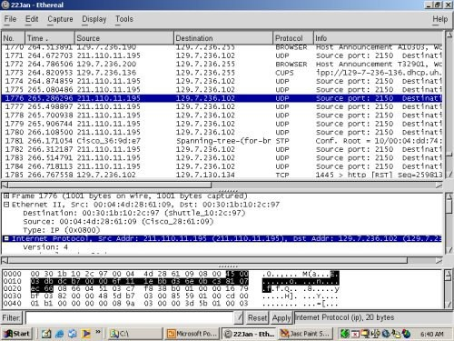
Protocol Analysis Sniffer

Slide 16
Network Forensics
Most networks have the capability to track user activity
Capabilities may or may not be configured
May or may not be corrupted by an intruder
Frequently involve multiple machines
Includes discovery of IP addresses, host names, network routes and Web site information.

Slide 17
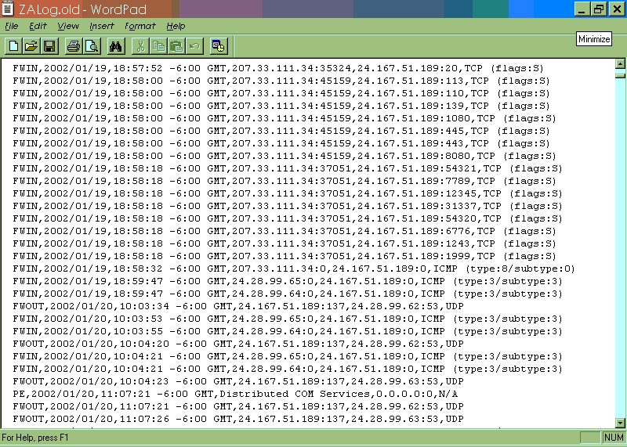
Sample Log File

Slide 18
Internet Forensics
Remote machines on the Internet also have the capability of tracking events.
Case Study University of Tulsa Camera Equipment Theft
Several thousand dollars worth of camera equipment shipped to a shack.
After delivery and prior to LE being notified, the shack was knocked down.
Utilizing Internet Forensics, culprits were identified and caught.

Slide 19
Computer or Communications Evidence?
May have an international scope.
Issues
Jurisdictions
Time and labor
Different laws apply to unread email than to information stored on a hard drive
Rome Labs Case Study

Slide 20
Digital Evidence
Digital evidence must be authentic and must be able to be proven that it has not been modified
Evidence Life Cycle
Discovery and recognition
Protection
Recording
Collection
Identification
Preservation
Transportation
Presentation in court
Return to owner

Slide 21
Evidence Characteristics
Sufficient, reliable, and relevant
Sufficient means it must be persuasive enough to convince a reasonable person of the validity of the findings.
Reliable, or competent, means it must be consistent with fact.
Relevant means it must have a reasonable and sensible relationship to the findings.

Slide 22
Rules of Evidence
Distinguish between hearsay and direct evidence
Require proof of authenticity and integrity
Chain of custody requires that:
No information has been added or changed
A complete copy was made
A reliable copying process was used
All media was secured.
Message Digest demonstrates integrity
Digital Signature demonstrates authentication and non repudiation

Slide 23
Evidence Handling
If evidence is handled improperly, investigation may be comprised.
A documented chain of custody must include:
Who collected the evidence?
How and where?
Who took possession?
How was it stored and protected?
Who took it out of storage?

Slide 24
Common Enterprise Problems
No established incident response team.
Evidence compromised while gathered
No established incident response policies
Evidence may be compromised prior to gathering
Inappropriate methodology
Peer review
Broken chain of custody
Appropriate evidence was gathered but can not be presented in court

Slide 25
Who Gathers Forensic Evidence?
Incident Response Team, or other trained professionals, respond to an incident.
Specific actions should be based on the specific incident and the organization’s Incident Response Policy.
An incident response team ensures that:
There is a group of properly skilled professionals.
There is a standard set of procedures
Resources and processes are available when an incident occurs.
Incident Response Team gathers evidence.

Slide 26
Types of Evidence
Best evidence -- Original or primary evidence
Secondary evidence -- A copy or oral description
Conclusive evidence -- Incontrovertible: overrides all other evidence
Hearsay Evidence -- (3rd party) not generally admissible

Slide 27
Hearsay Rule
Key for Computer Generated Evidence
Second Hand Evidence
Admissibility Based on Veracity and Competence of Source
Exceptions: Rule 803 of Federal Rules of Evidence allows Business Documents created at the time by person with knowledge, part of regular business, routinely kept, supported by testimony.

Slide 28
Hearsay E4ceptions
Computer generated records and other business records can fall into this category
Exceptions if records:
Are made during the regular conduct of business and authenticated by witnesses familiar with them
Relied upon in the regular course of business
Made by a person with knowledge of the records
In the custody of the witness on a regular basis

Slide 29
System Logs as Evidence
According to the US Federal Rules of Evidence:
Log files that are created routinely an contain information about acts and events made at specific times by, or from information transmitted by, a person with knowledge
Are not excluded by the hearsay rule.

Slide 30
Daubert Rules
To assist the lower courts in applying Daubert, the Court provided the following list of factors that courts should consider before ruling on the admissibility of scientific evidence:
Whether the theory or technique has been reliably tested;
Whether the theory or technique has been subject to peer review and publication;
What is the known or potential rate of error of the method used; and
Whether the theory or method has been generally accepted by the scientific community.

Slide 31
Surveillance, Search, and Seizure
Computer surveillance pertains to events, which passively or actively monitors events by using network sniffers, keyboard monitors, wiretaps, and line monitors
Active monitoring may require a search warrant.
To legally monitor an individual, the person had to have been warned ahead of time that her activities may be subject to this type of monitoring.
Organizational policy

Slide 33
Collecting Network Based Evidence

Slide 34
WHAT IS NETWORK-BASED EVIDENCE
Full-content network monitoring or the interception of electronic communications as network-based evidence
Collecting network-based evidence includes setting up a computer system to perform network monitoring, deploying the network monitor, and evaluating the effectiveness of the network monitor.
Catching the traffic is only a portion of the work; extracting meaningful results is the other challenge.
The analysis of network-based evidence includes reconstructing the network activity, performing low-level protocol analysis, and interpreting the network activity.

Slide 35
FINDING NETWORK-BASED EVIDENCE
Identify suspicious network traffic (possible sessions).
Replay or reconstruct the suspicious sessions (whether it is TCP, UDP, ICMP, or another protocol).
Interpret what occurred.

Slide 36
INVESTIGATING WINDOWS SYSTEMS
WHERE EVIDENCE RESIDES ON WINDOWS SYSTEMS
Volatile data in kernel structures
Slack space, where you can obtain information from previously deleted files that are unrecoverable
Free or unallocated space, where you can obtain previously deleted files, including damaged or inaccessible clusters
The logical file system
The event logs
The Registry, which you should think of as an enormous log file
Application logs not managed by the Windows Event Log Service
Temporary files created by many applications

Slide 38
The Recycle Bin (a hidden, logical file structure where recently deleted items can be found)
The printer spool
Sent or received email, such as the .pst files for Outlook mail

Slide 39
CONDUCTING A WINDOWS INVESTIGATION
Review all pertinent logs.
Perform keyword searches.
Review relevant files.
Identify unauthorized user accounts or groups.
Identify rogue processes and services.
Look for unusual or hidden files/directories.
Check for unauthorized access points.
Examine jobs run by the Scheduler service.
Analyze trust relationships.
Review security identifiers.

Slide 40
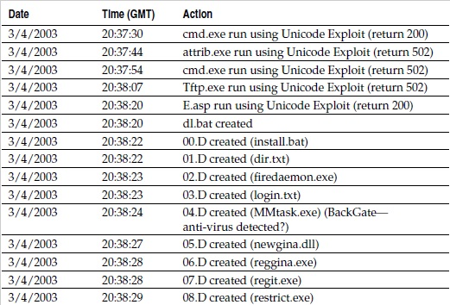
LOGS ON LIVE SYSTEM

Slide 41
TYPES OF NETWORK MONITORING
Event monitoring
Trap-and-Trace Monitoring
Full-content monitoring

Slide 42
Event monitoring
Event monitoring is based on rules or thresholds employed on the network-monitoring platform.
Events are simply alerts that something occurred on your network.
Traditional events are generated by a network IDS,
Events can also be created by network health monitoring software like MRTG (Multi Router Traffic Grapher) or NTOP.

Slide 43
Trap-and-Trace Monitoring
Non-content monitoring records the session or transaction data summarizing the network activity.
Law enforcement refers to such non-content monitoring as a pen register or a trap-and-trace.
It typically includes the protocol, IP addresses, and ports used by a network communication.
Counts of bytes of information sent by each side, and counts of packets sent by each side.

Slide 44
Full-content monitoring
Full-content monitoring yields data that includes the raw packets collected from the wire.
It offers the highest fidelity, because it represents the actual communication passed between computers on a network. Full-content data includes packet headers and payloads.

Slide 45
SETTING UP A NETWORK MONITORING SYSTEM
Network diagnostic and troubleshooting hardware can capture data reliably and usually are the most efficient at capturing data at the full rate of the monitored network segment.
Also having several drawbacks that make them unsuitable for performing network surveillance.
example, they lack remote management capabilities and proper storage space, and they usually cost a lot of money.

Slide 46
CHOOSING APPROPRIATE SOFTWARE
Some common commercial sniffer software packages include Sniffer Network Analyzer for Ethernet, Surveyor/Explorer, and Lan Analyzer.
Choosing an appropriate operating system is as important as choosing the appropriate sniffer software that you decide to use for network surveillance.
Silent Sniffers
A silent sniffer is a system that will not respond to any packets it receives — directed IP datagrams, broadcast, or multicast.
Implementing a silent sniffer is the most foolproof way of preventing intruders from discovering your monitoring system.
putting your listening interface into Stealth Mode

Slide 47
SETTING UP A NETWORK MONITORING SYSTEM
Network diagnostic and troubleshooting hardware can capture data reliably and usually are the most efficient at capturing data at the full rate of the monitored network segment.
Also having several drawbacks that make them unsuitable for performing network surveillance.
example, they lack remote management capabilities and proper storage space, and they usually cost a lot of money.

Slide 48
CHOOSING APPROPRIATE SOFTWARE
Some common commercial sniffer software packages include Sniffer Network Analyzer for Ethernet, Surveyor/Explorer, and Lan Analyzer.
Choosing an appropriate operating system is as important as choosing the appropriate sniffer software that you decide to use for network surveillance.
Silent Sniffers
A silent sniffer is a system that will not respond to any packets it receives — directed IP datagrams, broadcast, or multicast.
Implementing a silent sniffer is the most foolproof way of preventing intruders from discovering your monitoring system.
putting your listening interface into Stealth Mode

Slide 49
Silent Sniffer (HTTP)
Snort
Cache View

Slide 50
REGISTRY DATA COLLECTION
The Windows Registry is a collection of data files that stores vital configuration data for the system.
The operating system uses the Registry to store information about the hardware, software, and components of a system. You can think of the Registry as a log file, harboring a lot of data that is useful to investigators.
The Registry can reveal the software installed in the past, the security configuration of the machine
_ HKEY_CLASSES_ROOT
_ HKEY_CURRENT_USER
_ HKEY_LOCAL_MACHINE (abbreviated as HKLM)
_ HKEY_USERS
_ HKEY_CURRENT_CONFIG

Slide 51
HKEY_CLASSES_ROOT
often shortened as HKCR, It associated information, as well as a programmatic identifier (ProgID), Class ID (CLSID), and Interface ID (IID) data.
Registry Sub-keys in HKEY_CLASSES_ROOT
HKEY_CLASSES_ROOT\.avi
HKEY_CLASSES_ROOT\.bmp
HKEY_CLASSES_ROOT\.exe
HKEY_CLASSES_ROOT\.html
HKEY_CLASSES_ROOT\.pdf
HKEY_CLASSES_ROOT\Audio
CDHKEY_CLASSES_ROOT\dllfile

Slide 52
HACKER TOOL

Slide 53
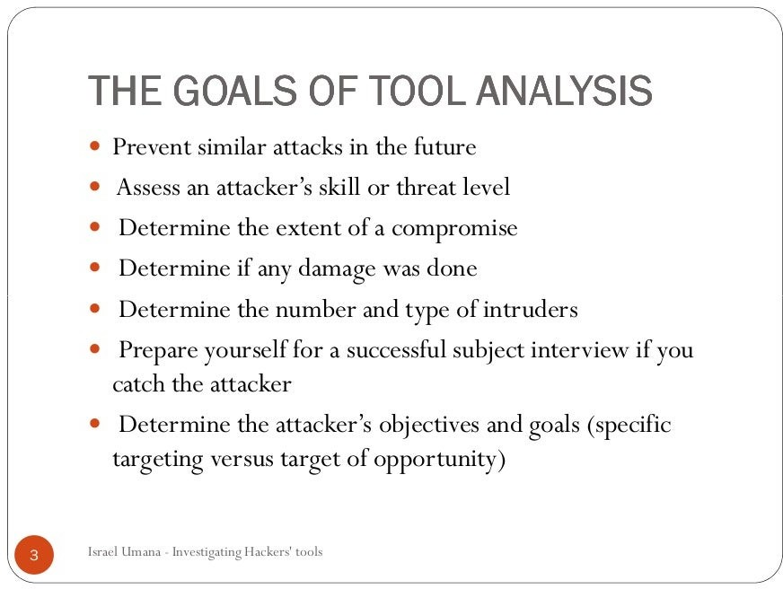

Slide 54
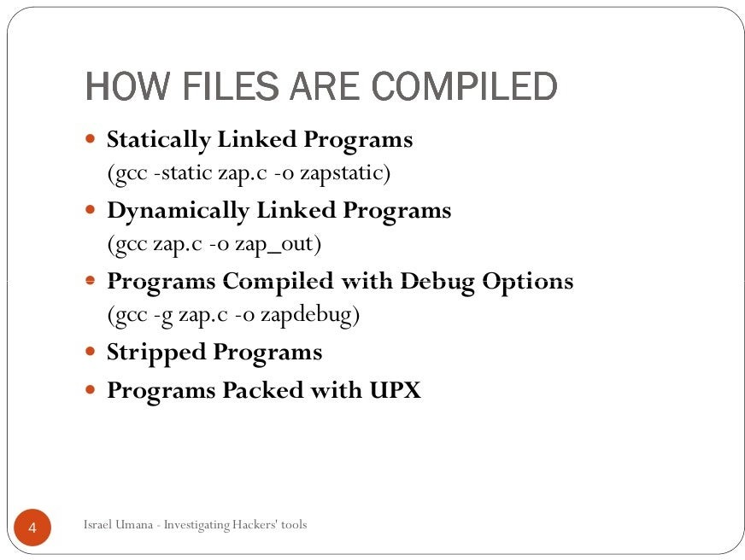

Slide 55
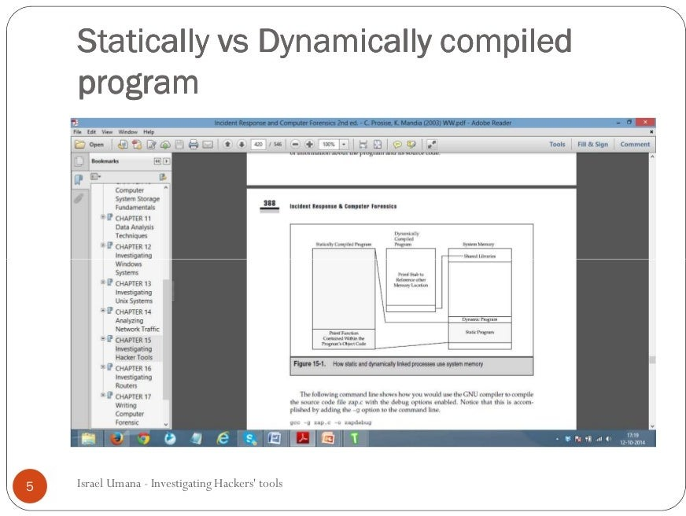

Slide 56
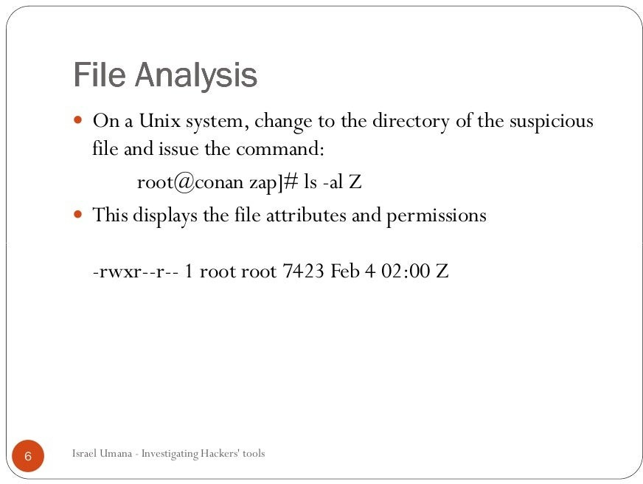

Slide 57
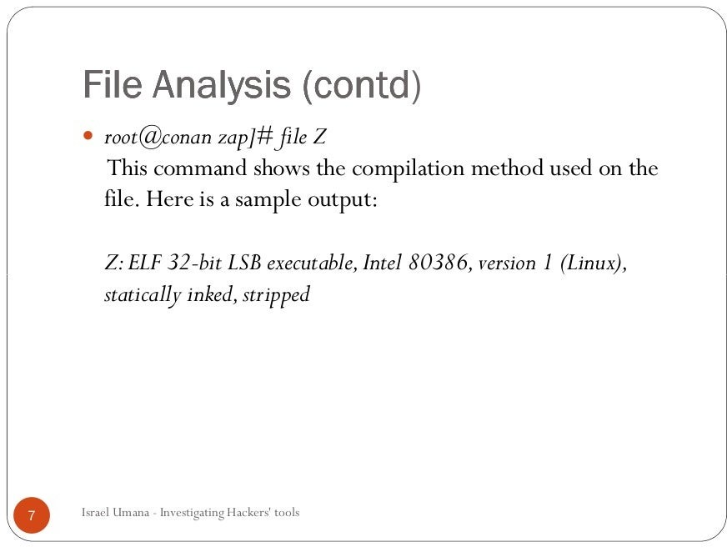

Slide 58
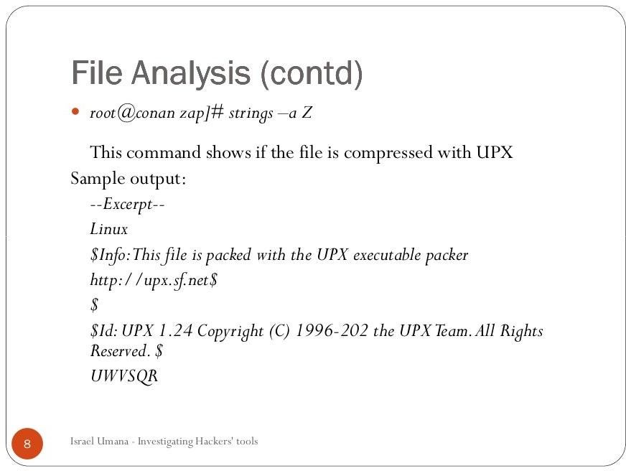

Slide 59
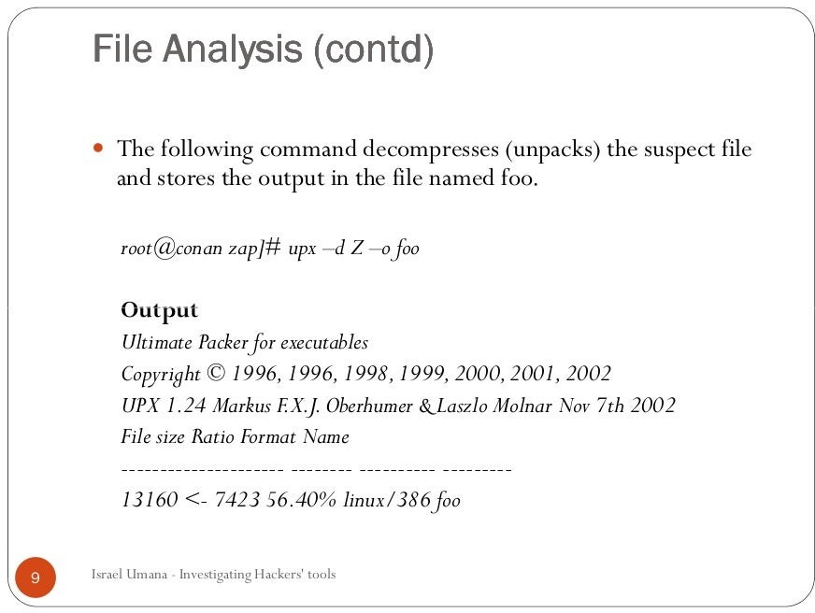

Slide 60
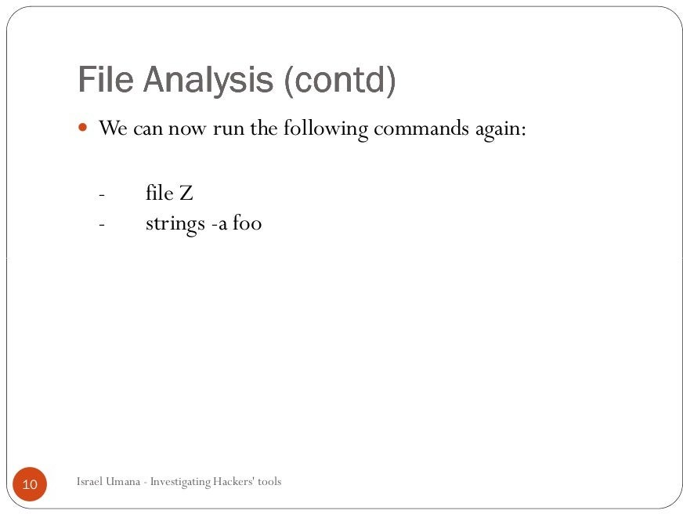

Slide 61
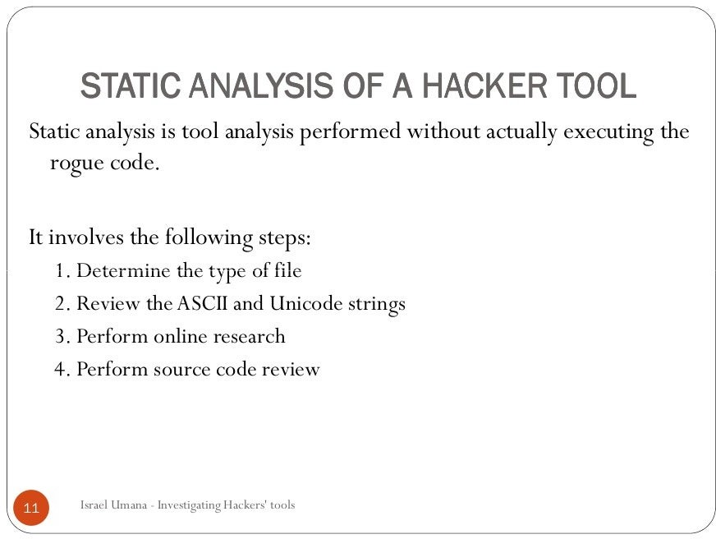

Slide 62
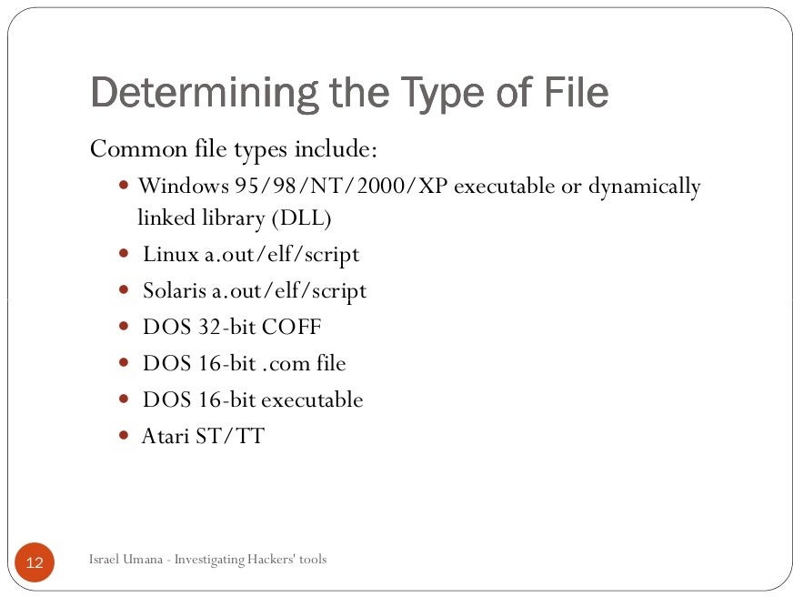

Slide 63
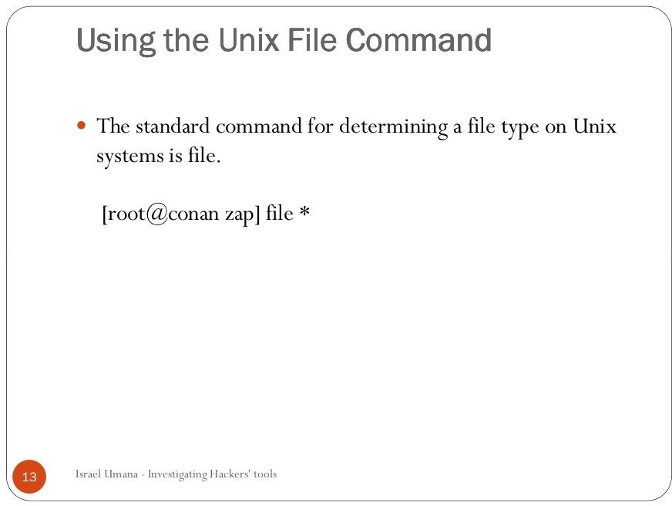

Slide 64
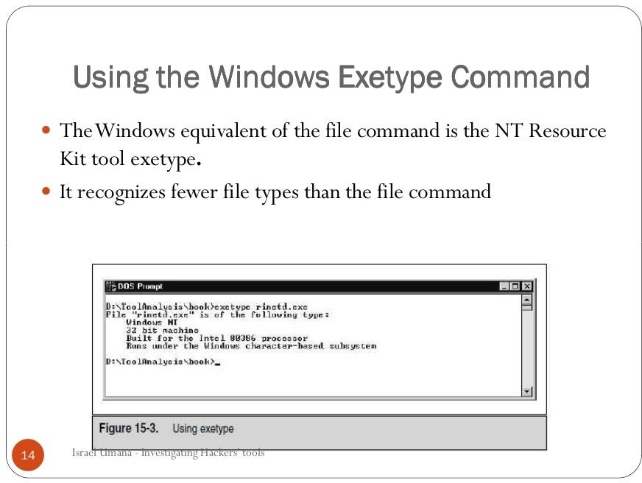

Slide 65
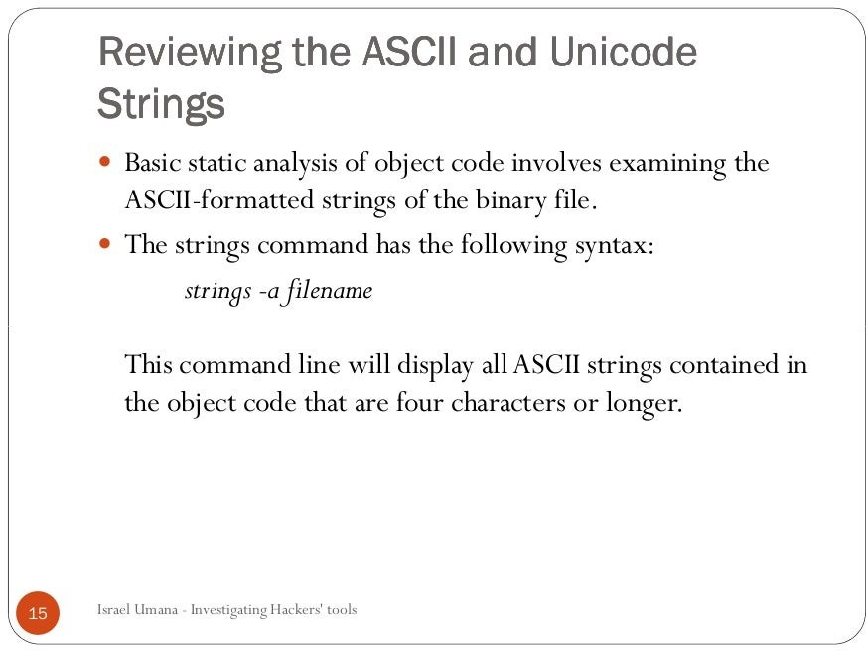

Slide 66
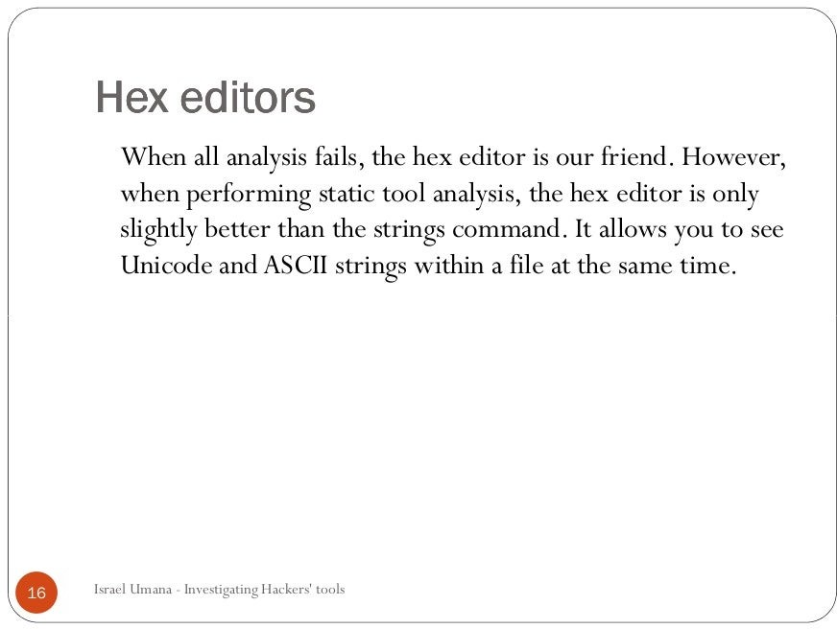

Slide 67
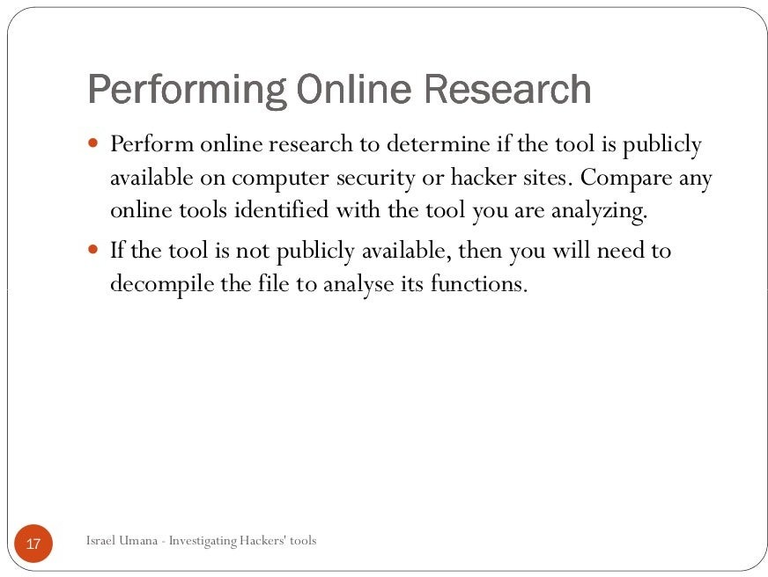

Slide 68
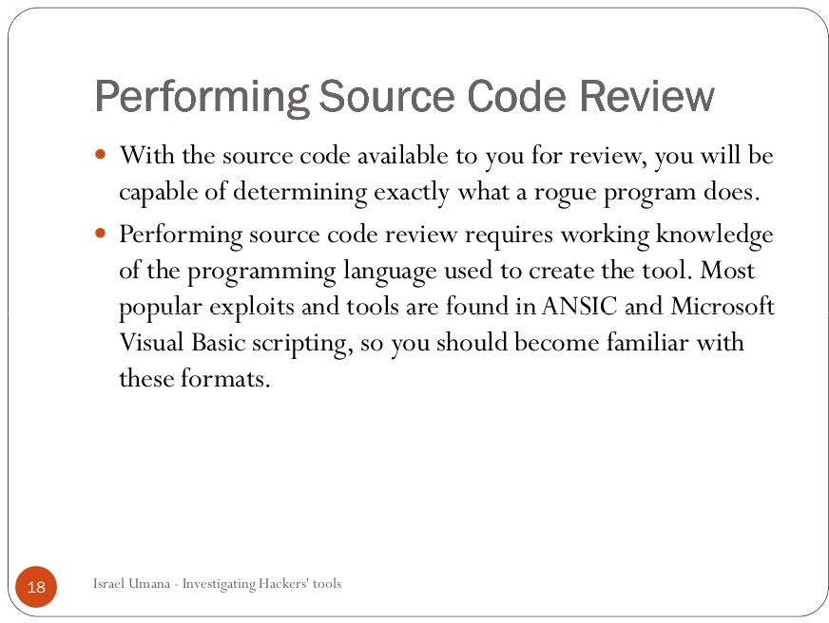

Slide 69
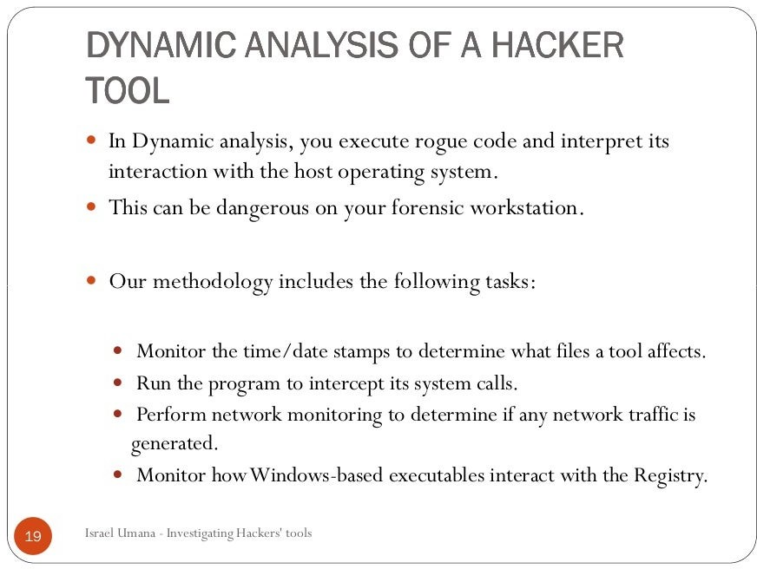

Slide 70
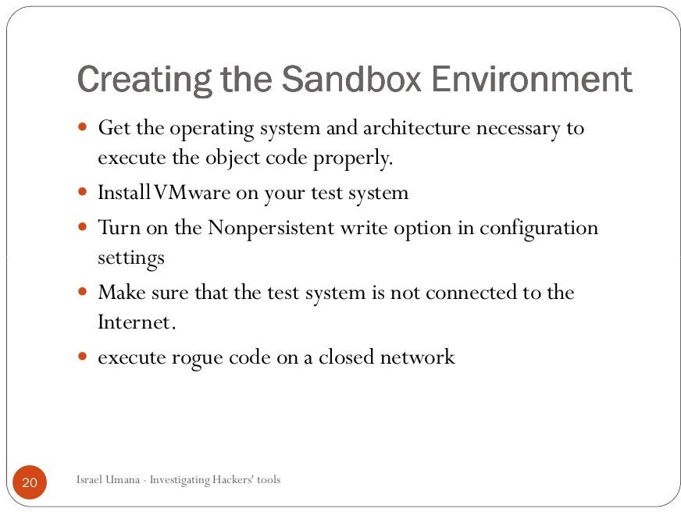

Slide 71
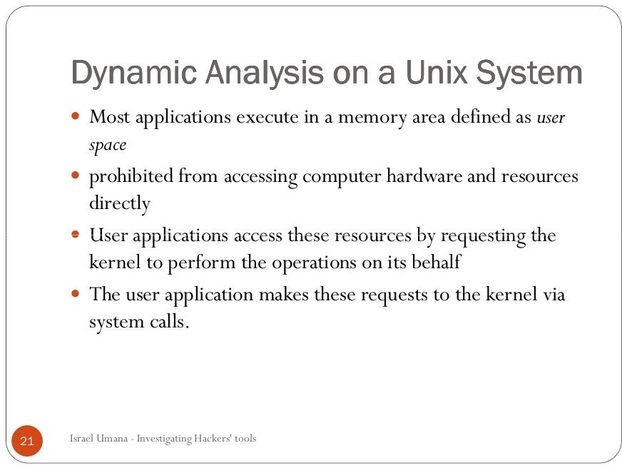

Slide 72
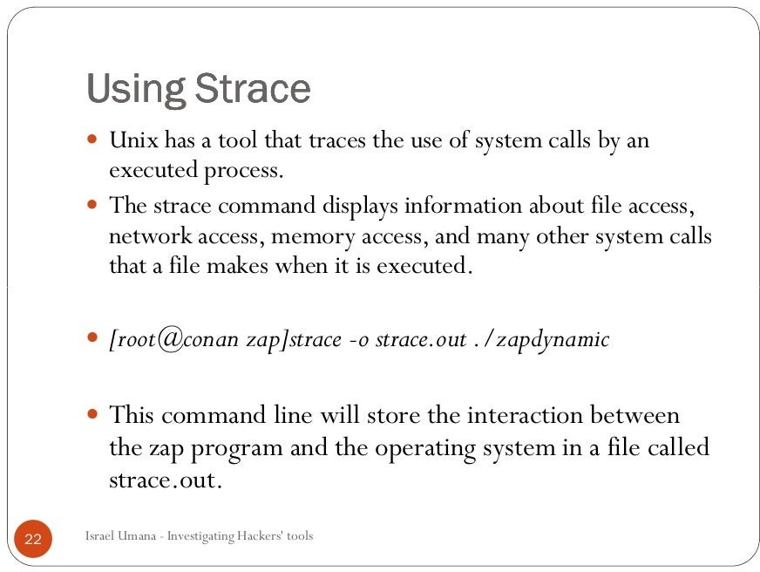

Slide 73
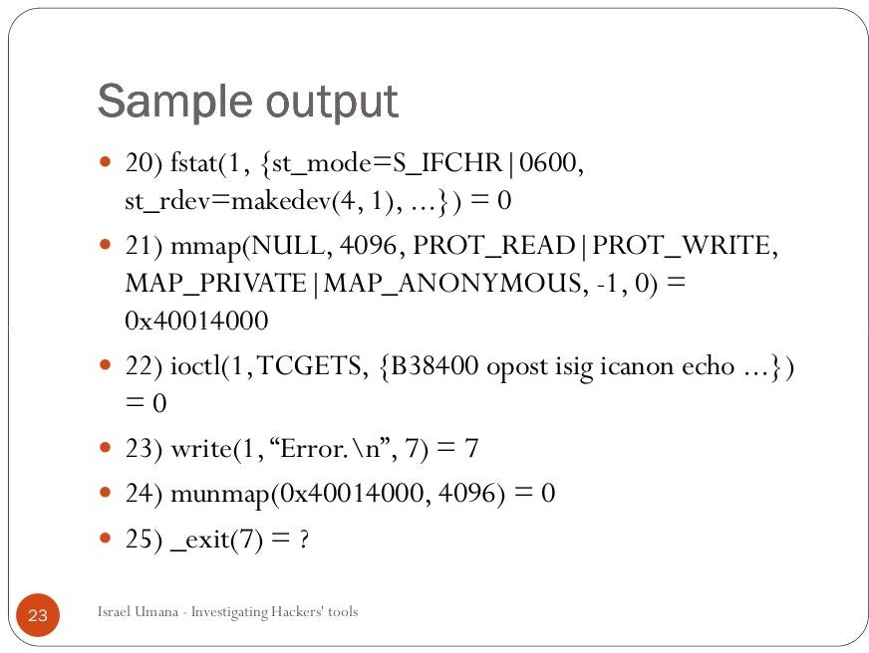

Slide 74
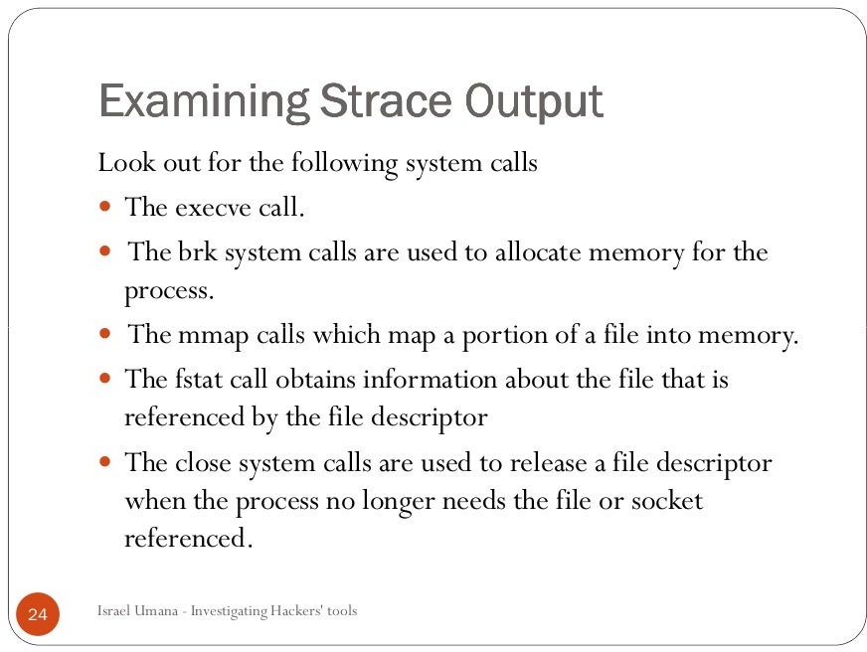

Slide 75
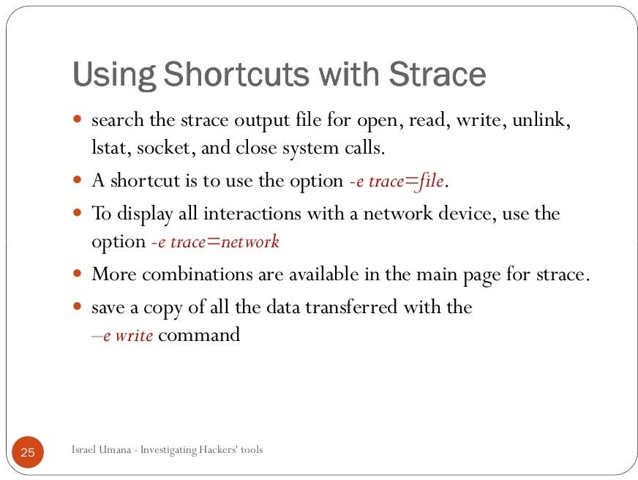

Slide 76
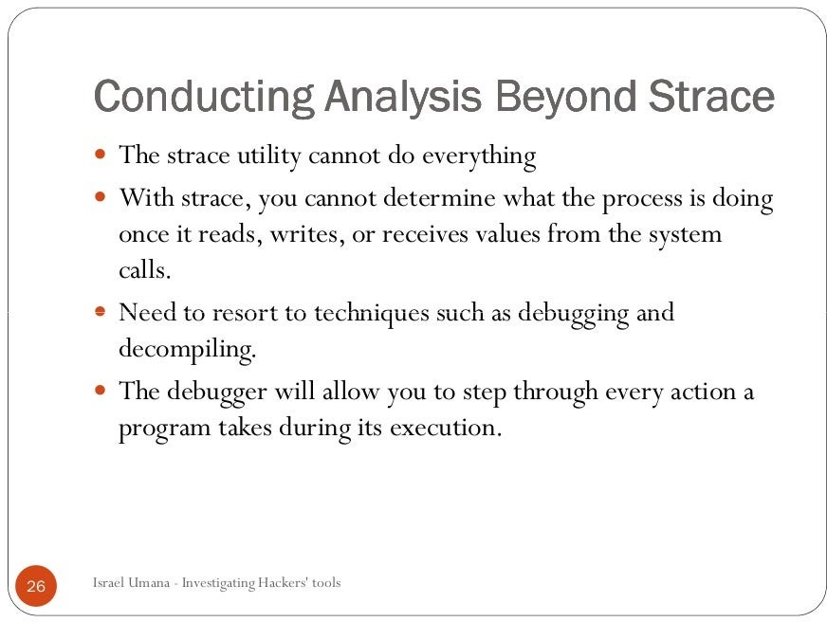

Slide 77
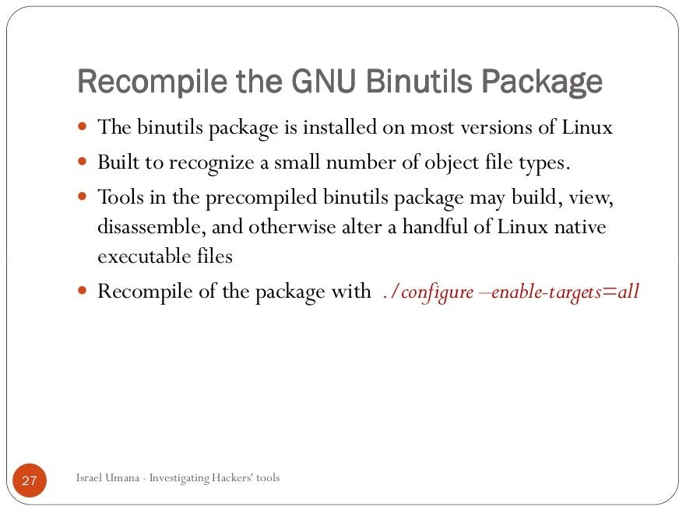

Slide 78
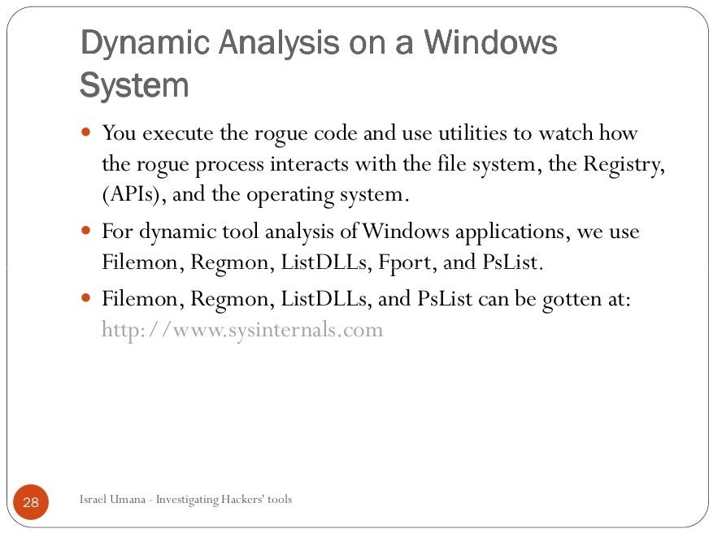

Slide 79
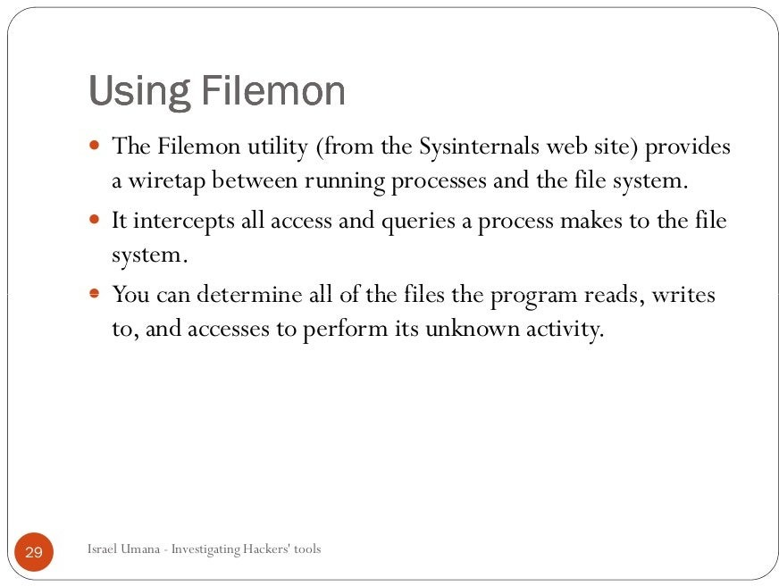

Slide 80
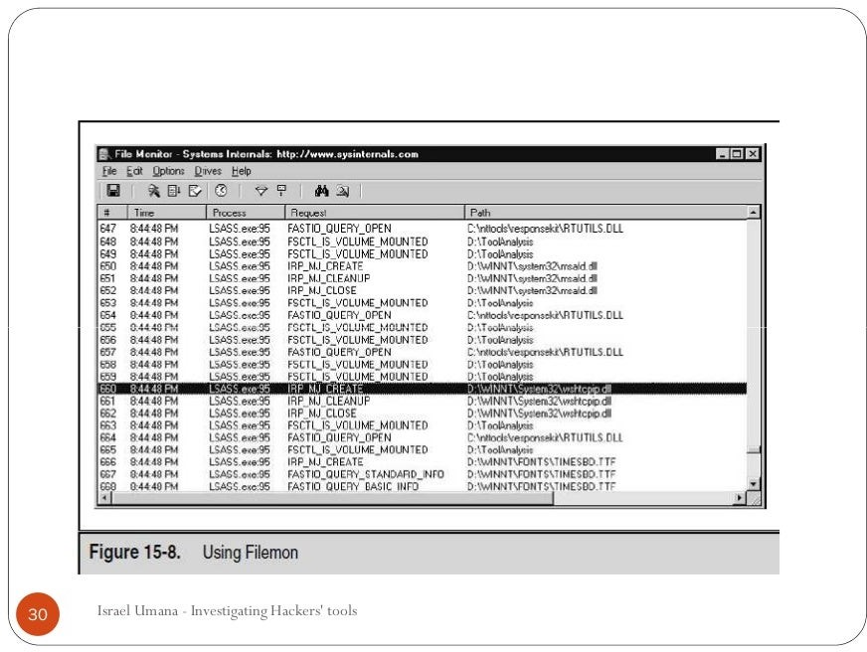

Slide 81
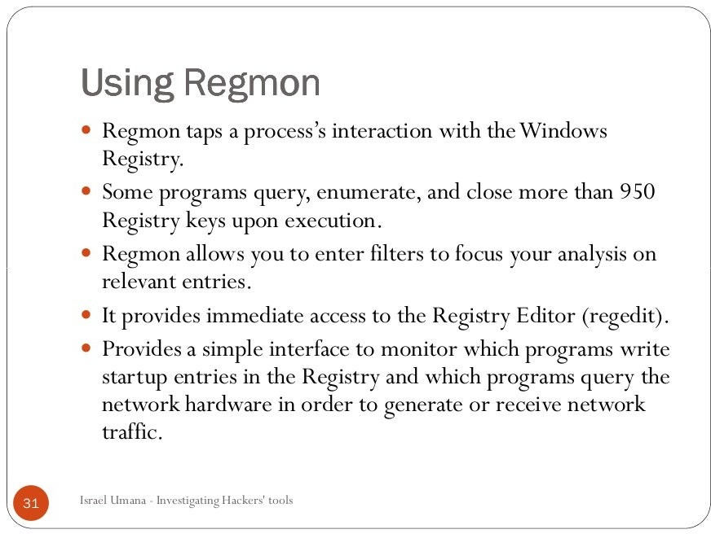

Slide 82
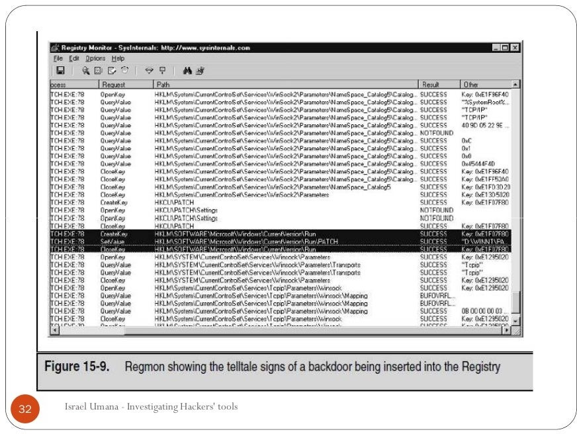

Slide 83
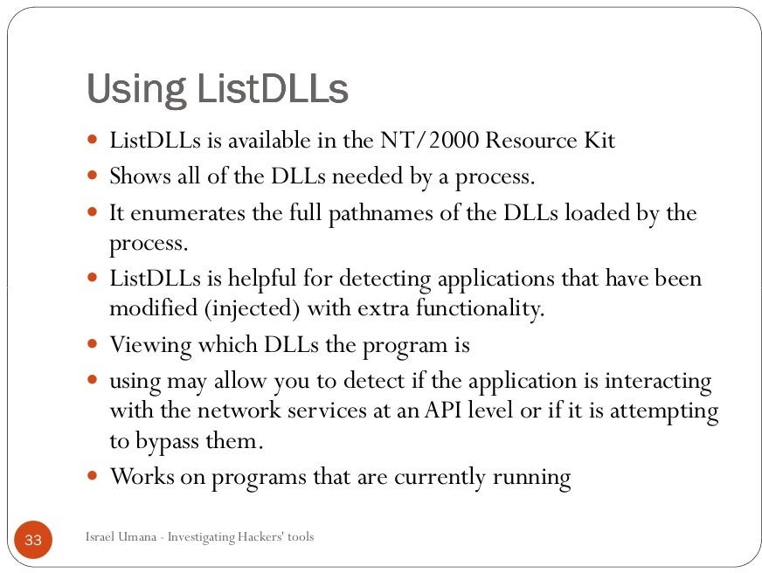

Slide 84
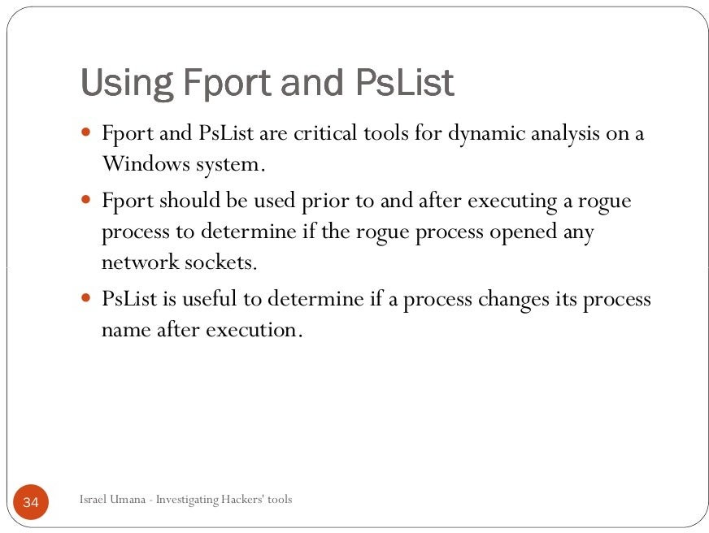

Slide 85
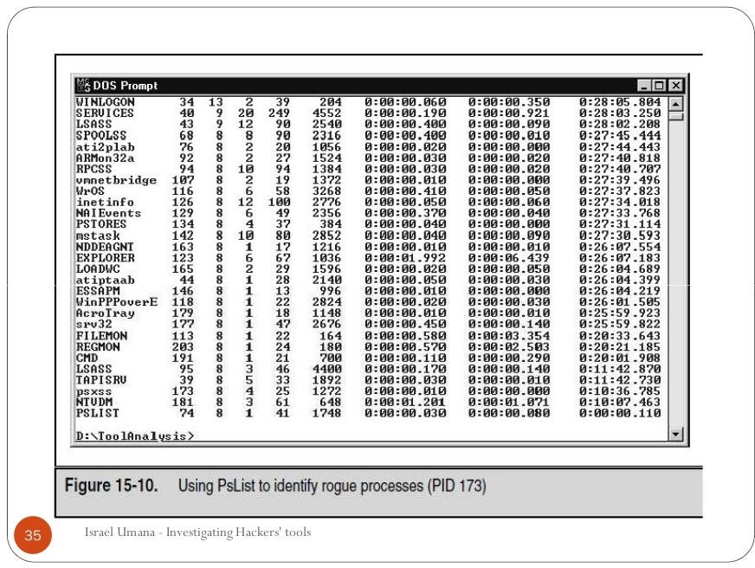

Slide 86
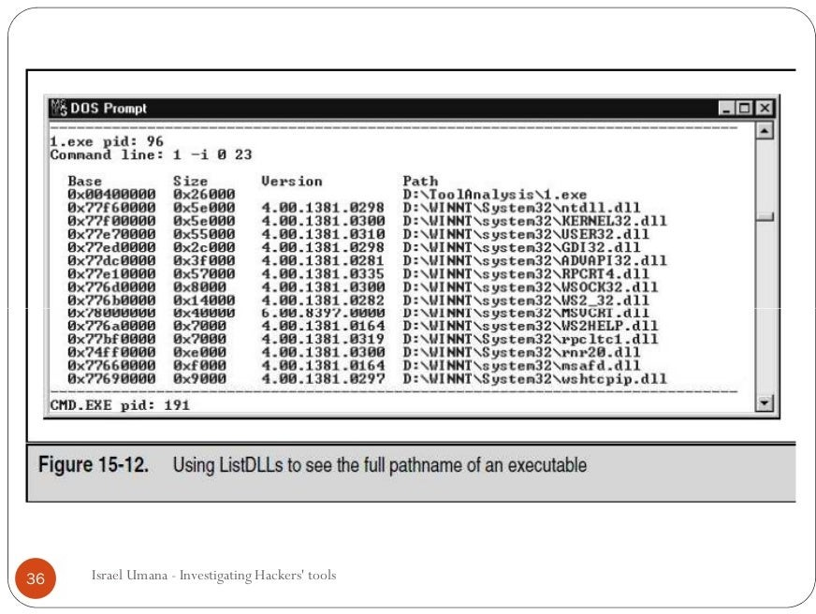

Slide 87
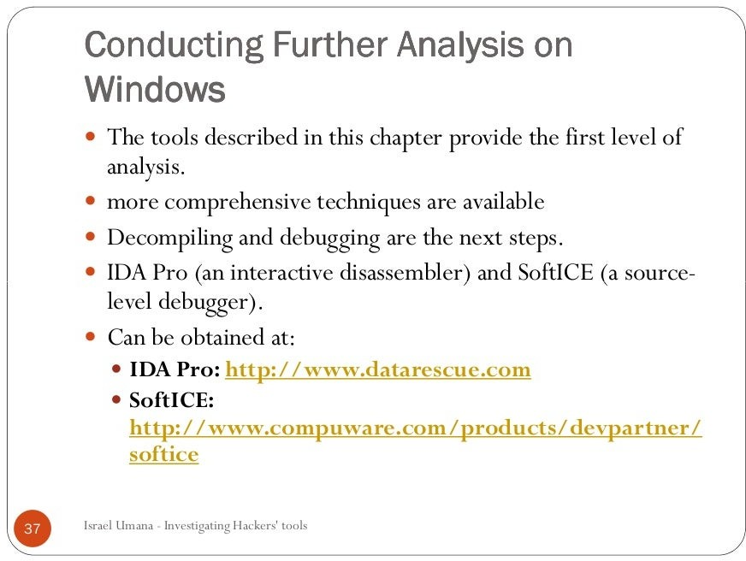

Slide 88
Evaluating Computer Forensics Tool Needs

Slide 89
Evaluating Computer Forensics Tool Needs
Look for versatility, flexibility, and robustness
OS
File system(s)
Script capabilities
Automated features
Vendor’s reputation for support
Keep in mind what application files you will be analyzing

Slide 90
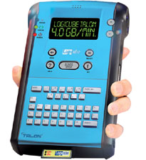
Types of Computer Forensics Tools
Hardware forensic tools
Range from single-purpose
components to complete computer
systems and servers
Software forensic tools
Types
Command-line applications
GUI applications
Commonly used to copy data from a suspect’s disk drive to an image file
Logicube Talon (link Ch 7a)

Slide 91
Tasks Performed by Computer Forensics Tools
Five major categories:
Acquisition
Validation and discrimination
Extraction
Reconstruction
Reporting

Slide 92
Acquisition
Making a copy of the original drive
Acquisition subfunctions:
Physical data copy
Logical data copy
Data acquisition format
Command-line acquisition
GUI acquisition
Remote acquisition
Verification

Slide 93
Acquisition (continued)
Two types of data-copying methods are used in software acquisitions:
Physical copying of the entire drive
Logical copying of a disk partition
The formats for disk acquisitions vary
From raw data to vendor-specific proprietary compressed data
You can view the contents of a raw image file with any hexadecimal editor

Slide 94
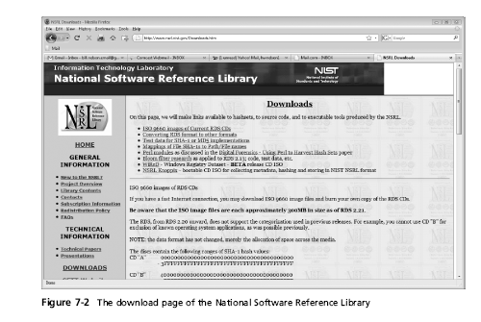
Tasks Performed by Computer Forensics Tools (continued)

Slide 95
Validation and discrimination (continued)
Many computer forensics programs include a list of common header values
With this information, you can see whether a file extension is incorrect for the file type
Most forensics tools can identify header values

Slide 96
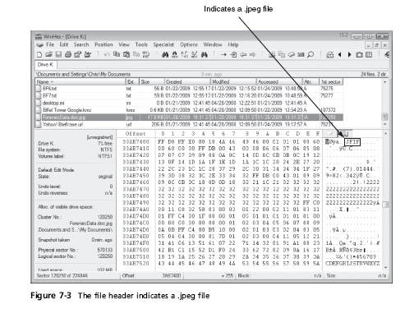

Slide 97
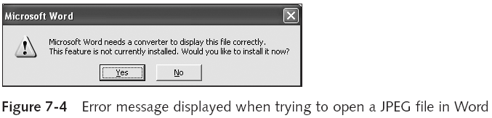
Tasks Performed by Computer Forensics Tools (continued)

Slide 98
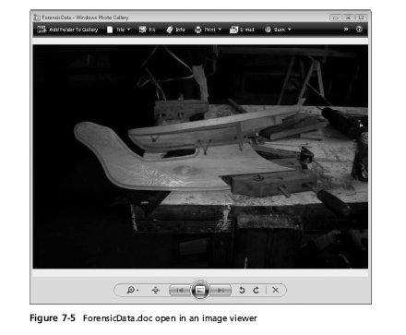

Slide 99
Extraction
Recovery task in a computing investigation
Most demanding of all tasks to master
Recovering data is the first step in analyzing an investigation’s data

Slide 100
Extraction (continued)
Subfunctions
Data viewing
Keyword searching
Decompressing
Carving (reconstructing file fragments)
Decrypting
Bookmarking
Keyword search speeds up analysis for investigators

Slide 101
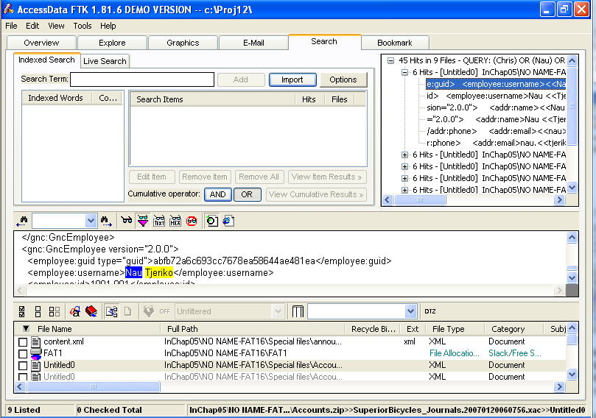
FTK's Search Pane

Slide 102
Extraction (continued)
From an investigation perspective, encrypted files and systems are a problem
Many password recovery tools have a feature for generating potential password lists
For a password dictionary attack
If a password dictionary attack fails, you can run a brute-force attack

Slide 103
Reconstruction
Re-create a suspect drive to show what happened during a crime or an incident
Subfunctions
Disk-to-disk copy
Image-to-disk copy
Partition-to-partition copy
Image-to-partition copy
This is easiest if a matching blank hard disk is available, same make and model

Slide 104
Reconstruction (continued)
Some tools that perform an image-to-disk copy:
SafeBack
SnapBack
EnCase
FTK Imager
ProDiscover

Slide 105
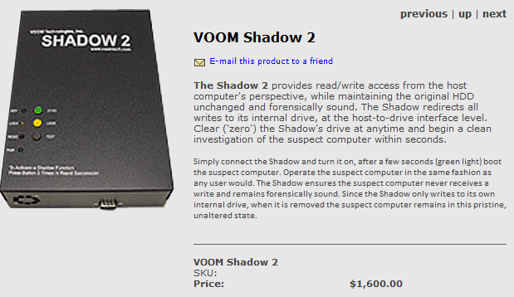
VOOM Shadow 2
For write-blocked courtroom demos using real original drive, use Voom Shadow 2 (link Ch 7b)

Slide 106
Reporting
To complete a forensics disk analysis and examination, you need to create a report
Subfunctions
Log reports
Report generator
Use this information when producing a final report for your investigation

Slide 107
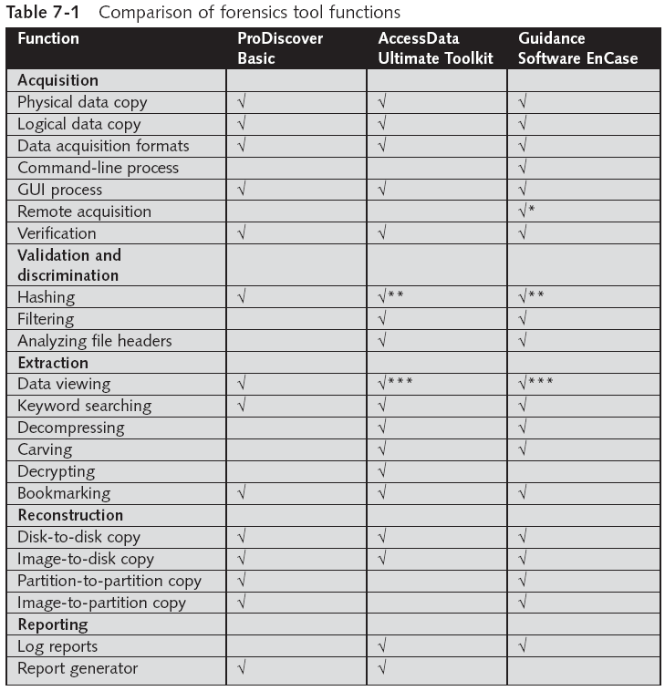
Tool Comparisons

Slide 108
Other Considerations for Tools
Considerations
Flexibility
Reliability
Expandability
Keep a library with older version of your tools
Create a software library containing older versions of forensics utilities, OSs, and other programs

Slide 109
Computer Forensics Software Tools

Slide 110
Computer Forensics Software Tools
The following sections explore some options for command-line and GUI tools in both Windows and UNIX/Linux

Slide 111
Command-line Forensic Tools
The first tools that analyzed and extracted data from floppy disks and hard disks were MS-DOS tools for IBM PC file systems
Norton DiskEdit
One of the first MS-DOS tools used for computer investigations
Advantage
Command-line tools require few system resources
Designed to run in minimal configurations

Slide 112
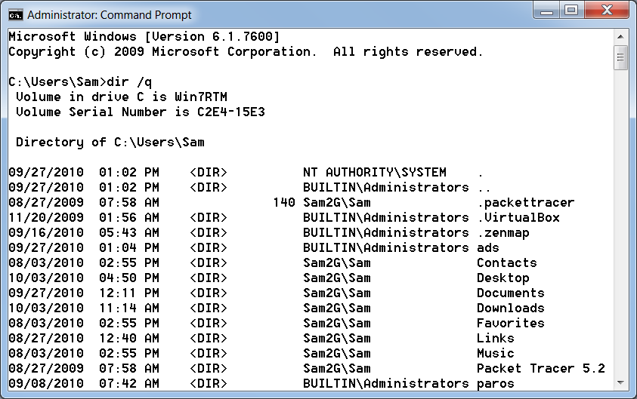
DIR /Q
Shows file owner

Slide 113
UNIX/Linux Forensic Tools
*nix platforms have long been the primary command-line OSs
SMART
Designed to be installed on numerous Linux versions
Can analyze a variety of file systems with SMART
Many plug-in utilities are included with SMART
Another useful option in SMART is its hex viewer
Link Ch 7d

Slide 114
UNIX/Linux Forensic Tools (continued)
Helix
One of the easiest suites to begin with
You can load it on a live Windows system
Loads as a bootable Linux OS from a cold boot
Autopsy and SleuthKit
Sleuth Kit is a Linux forensics tool
Autopsy is the GUI/browser interface used to access Sleuth Kit’s tools

Slide 116
UNIX/Linux Forensic Tools (continued)
Knoppix-STD
Knoppix Security Tools Distribution (STD)
A collection of tools for configuring security measures, including computer and network forensics
Knoppix-STD is forensically sound
Doesn’t allow you to alter or damage the system you’re analyzing
Knoppix-STD is a Linux bootable CD

Slide 117
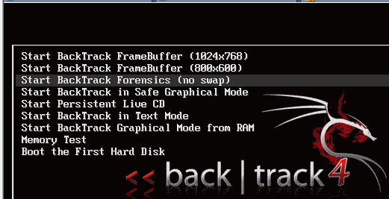
BackTrack
BackTrack 4 has a Forensics Mode
But it’s not the default boot mode, so you need to be careful

Slide 118
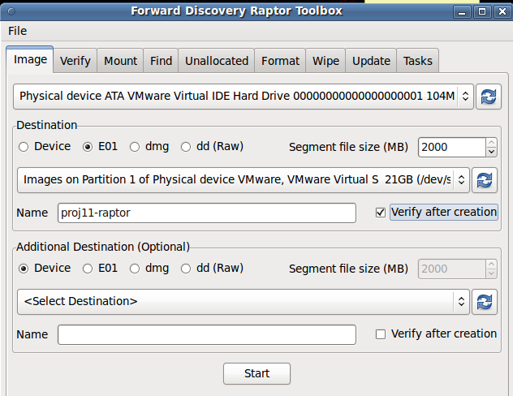
Raptor
Forensic LiveCD (link Ch 7e)

Slide 119
Other GUI Forensic Tools
Simplify computer forensics investigations
Help training beginning investigators
Most of them come into suites of tools
Advantages
Ease of use
Multitasking
No need for learning older OSs

Slide 120
Other GUI Forensic Tools (continued)
Disadvantages
Excessive resource requirements
Produce inconsistent results
Create tool dependencies

Slide 121
Computer Forensics Hardware Tools

Slide 122
Computer Forensics Hardware Tools
Technology changes rapidly
Hardware eventually fails
Schedule equipment replacements
When planning your budget consider:
Failures
Consultant and vendor fees
Anticipate equipment replacement

Slide 123
Forensic Workstations
Carefully consider what you need
Categories
Stationary
Portable
Lightweight
Balance what you need and what your system can handle

Slide 124
Forensic Workstations (continued)
Police agency labs
Need many options
Use several PC configurations
Private corporation labs
Handle only system types used in the organization
Keep a hardware library in addition to your software library

Slide 125
Building your Own Forensic Workstation
Not as difficult as it sounds
Advantages
Customized to your needs
Save money
Disadvantages
Hard to find support for problems
Can become expensive if careless
Also need to identify what you intend to analyze

Slide 126
Purchasing a Forensic Workstation
You can buy one from a vendor as an alternative
Examples
F.R.E.D.
F.I.R.E. IDE
Having vendor support can save you time and frustration when you have problems
Can mix and match components to get the capabilities you need for your forensic workstation

Slide 127
Using a Write-Blocker
Write-blocker
Prevents data writes to a hard disk
Software-enabled blockers
Software write-blockers are OS dependant
Example: PDBlock from Digital Intelligence
DOS only, not Windows (link Ch 6f)
Hardware options
Ideal for GUI forensic tools
Act as a bridge between the suspect drive and the forensic workstation

Slide 128
Using a Write-Blocker (continued)
Can navigate to the blocked drive with any application
Discards the written data
For the OS the data copy is successful
Connecting technologies
FireWire
USB 2.0
SCSI controllers

Slide 129
Recommendations for a Forensic Workstation
Determine where data acquisitions will take place
Data acquisition techniques
USB 2.0
FireWire
Expansion devices requirements
Power supply with battery backup
Extra power and data cables

Slide 130
Recommendations for a Forensic Workstation (continued)
External FireWire and USB 2.0 ports
Assortment of drive adapter bridges
Ergonomic considerations
Keyboard and mouse
A good video card with at least a 17-inch monitor
High-end video card and monitor
If you have a limited budget, one option for outfitting your lab is to use high-end game PCs

Slide 131
Validating and Testing Forensic Software

Slide 132
Validating and Testing Forensic Software
Make sure the evidence you recover and analyze can be admitted in court
Test and validate your software to prevent damaging the evidence

Slide 133
Using National Institute of Standards and Technology (NIST) Tools
Computer Forensics Tool Testing (CFTT) program
Manages research on computer forensics tools
NIST has created criteria for testing computer forensics tools based on:
Standard testing methods
ISO 17025 criteria for testing items that have no current standards
ISO 5725

Slide 134
Using National Institute of Standards and Technology (NIST) Tools (continued)
Your lab must meet the following criteria
Establish categories for computer forensics tools
Identify computer forensics category requirements
Develop test assertions
Identify test cases
Establish a test method
Report test results
Also evaluates drive-imaging tools
See link Ch 7g

Slide 135
Using National Institute of Standards and Technology (NIST) Tools (continued)
National Software Reference Library (NSRL) project
Collects all known hash values for commercial software applications and OS files
Uses SHA-1 to generate a known set of digital signatures called the Reference Data Set (RDS)
Helps filtering known information
Can use RDS to locate and identify known bad files

Slide 136
Using Validation Protocols
Always verify your results
Use at least two tools
Retrieving and examination
Verification
Understand how tools work
One way to compare results and verify a new tool is by using a disk editor
Such as Hex Workshop or WinHex
But it won't work with encrypted or compressed files

Slide 137
Using Validation Protocols (continued)
Disk editors
Do not have a flashy interface
Reliable tools
Can access raw data
Computer Forensics Examination Protocol
Perform the investigation with a GUI tool
Usually FTK or EnCase
Verify your results with a disk editor
If a file is recovered, compare hash values obtained with both tools

Slide 138
Using Validation Protocols (continued)
Computer Forensics Tool Upgrade Protocol
Test
New releases
OS patches and upgrades
If you find a problem, report it to forensics tool vendor
Do not use the forensics tool until the problem has been fixed
Use a test hard disk for validation purposes
Check the Web for new editions, updates, patches, and validation tests for your tools

